Slide 1
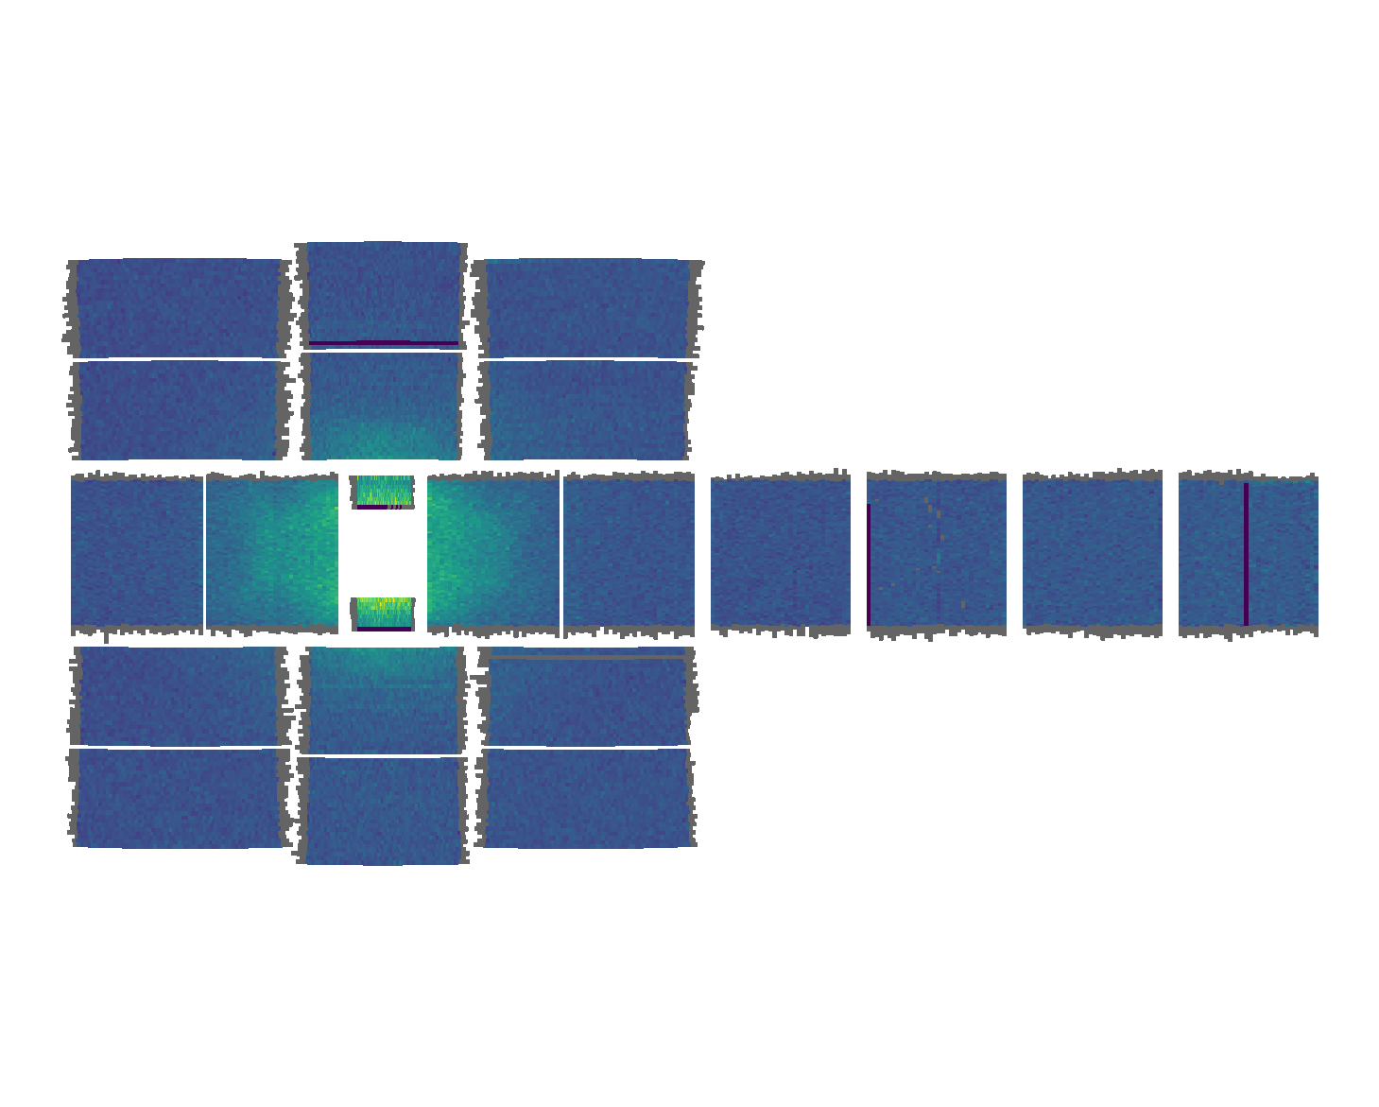
Fe_ei1400; Mantid instrument view and instrument_view_cut

Slide 2
Coordinates: A⁻¹ !!!; Remove cylindrical background, then remove 1D background calculated from moving BG to first BZ
Fe_ei1400; 100mEv
Bckgrd after cyl bckgrd removal

Slide 3
w1bz(Energy)_dE(fg/bg)=cut(sqw(Energy)meV_Bz_(fg/bg),2.209*[0,2],2.209*[0,2],2.209*[0,2],[]);
For 1400meV; BG

Slide 4
Coordinates: A⁻¹ !!!
Fe_ei800; 100mEv

Slide 5
Fe_ei800; 200mEv

Slide 6
Fe_ei800; 300mEv

Slide 7
Fe_ei400; 100mEv

Slide 8
w1bz(Energy)_dE(fg/bg)=cut(sqw(Energy)meV_Bz_(fg/bg),2.209*[0,2],2.209*[0,2],2.209*[0,2],[]);
For 400meV; no BG for dE>~270
For 800meV; BG everywhere?

Slide 9
1D BG removal (green line on 1D slide) 400mEv

Slide 10
Coverage

Slide 11
Coverage

Slide 12
1D BG removal (green line on 1D slide) 800mEv

Slide 13
4D BG removal 1400mEv

Slide 14
coverage

